Slide 1
MASAR
Machine Snapshot, Archiving, and Retrieve

Slide 2
MASAR
MASAR
A save/restore tool
Machine Snapshot, Archiving, and Retrieve
EPICS V4 Service to snapshot machines
General purpose tool
Globally handle PVs distributed in different IOCs
Machine
A collection of EPICS PVs
Snapshot
Data at specific time point
Value, time stamp, connection status, alarm status, alarm severity
Similar, but different purpose tools
Autosave
Single IOC bumpless rebooting
Archiver
Archive periodically
Save time serially data
MASAR Status Update and FRIB High Level Controls Progress - Guobao Shen FRIB 2016-09-21

Slide 3
MASAR: Machine Snapshot, Archiving, and Retrieve
Core features:
Allows for the creation of user defined collection of PV’s across multiple IOCs called a MASAR configuration
Snapshot machine status for given configuration
Restore machine status back to snapshot point
Both snapshots and configurations can be tagged and queried

Slide 4
MASAR Architecture
PyQt
Scripting
CS-Studio/MASAR
MASAR Client Python Library pvAccess Client
pvAccess Client Library (Java)
pvAccess
MASAR Server (EPICS V4 Engine)
DSL-PY Module (C++ <->Python)
Gather/C++
PYMASAR (Python)
SQLite
Channel Access
MongoDB
IOC
IOC
IOC
Restore
MASAR Status Update and FRIB High Level Controls Progress - Guobao Shen FRIB 2016-09-21

Slide 5
Save Restore Client

Slide 6
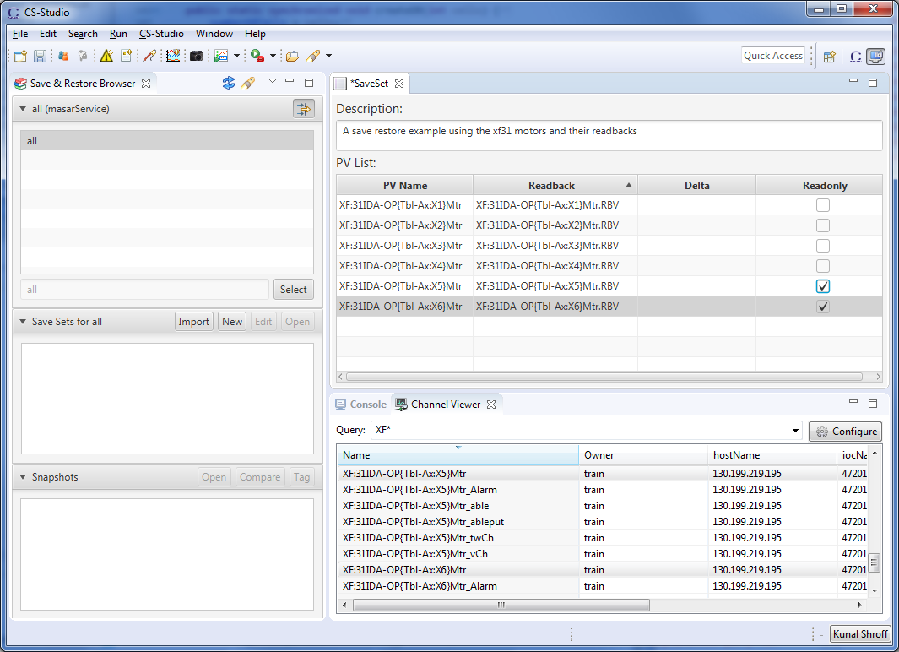
CS-STUDIO MASAR: Editor
Create a configuration of setpoint pv’s
Pair setpoint and readback pv’s
Tag pv’s that are to be excluded from restore
Define deltas

Slide 7
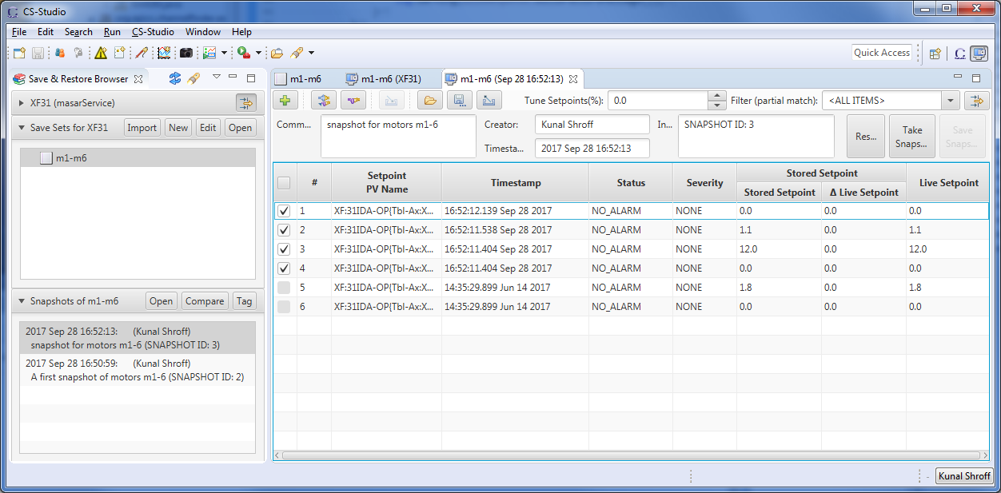
Masar cs-studio client snapshot viewer
Notes:
Create configuration

Slide 8
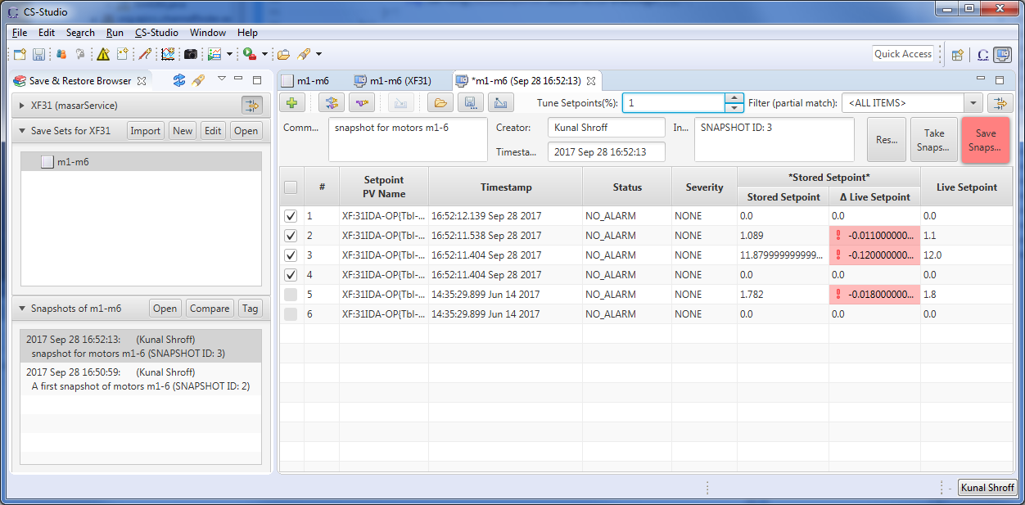
Masar cs-studio client snapshot viewer
Notes:
Take a snapshot

Slide 9
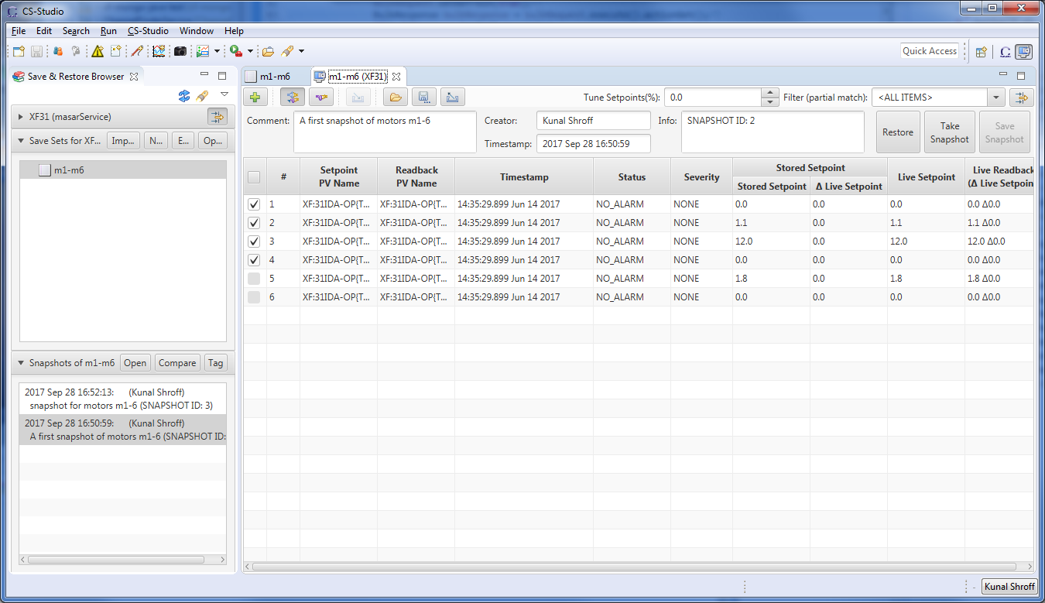
Masar cs-studio client snapshot viewer
Notes:
Take a snapshot

Slide 10
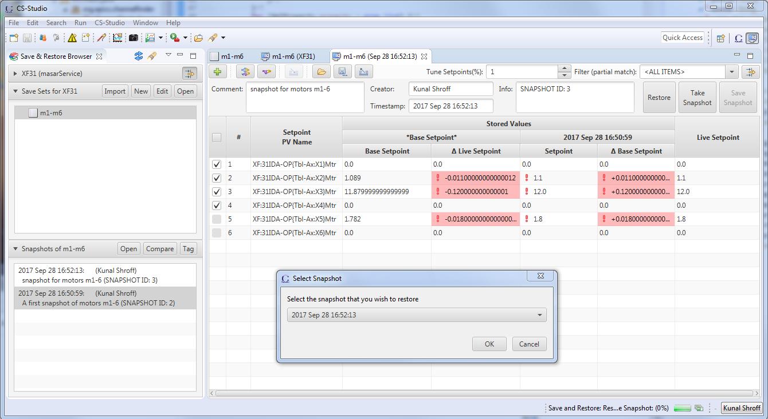
Masar cs-studio client snapshot viewer
Notes:
Take a snapshot

Slide 11
Exercise
Select the MASAR data provider
Create a “New” MASAR configuration
Save the newly created MASAR configuration
“Open” the previously created MASAR configuration in preparation for taking a snapshot
“Take Snapshot” and “Save Snapshot”
You can take multiple snapshots for the same configuration
“Compare” multiple snapshots, edit setpoint values, “Restore” snapshot

Slide 12
MASAR service API

Slide 13
Service calls
https://github.com/mdavidsaver/masarService/blob/master/interface.md
storeServiceConfig
Create/Replace an existing configuration
saveSnapshot & updateSnapshotEvent
Take and Save a snapshot
retrieveServiceConfigs
Query for Configurations
retrieveServiceEvents
retrieveSnapshot

